Slide 1


Group 5:
Dinesh Padmanabhan, Michael Pagan,
Noah Feldman, Zoey Zhao

Slide 2
Overview
Introduction
Key Concepts
Architecture Overview
Features & Methods
Specific Characteristics
Comparisons to other databases
When TO use & NOT use OrientDB
Advantages and Drawbacks
Current users
Important Clients
Case Studies
Setup options
Licensing
Pricing
Cloud based options
Market metrics
Demo

Slide 3
Is it possible to have a database that is FAST, SCALABLE, FLEXIBLE all at the same time?

Slide 4
Introduction
OrientDB
An open source NoSQL database management system written in Java.
The first Multi-Model database, supporting graph, document, key/value, and object models
But the relationship are managed as in graph databases with direct connections between records.
It brings together the power of graphs and the flexibility of documents into one scalable high-performance operational database.

Slide 5
History
2010
Originally authored by Luca Garulli
Initial release this year
2012 - 2014
Storage engine was redeveloped by Andrey Lomakin
2015
Has been covered by media outlets and is the winner of the 2015
InfoWorld Bossie award
2017
The third most popular graph database according to the DB-Engines graph database ranking in September
2020
OrientDB 3.0 released in March

Slide 6
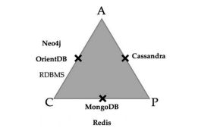
Key Concepts
TRANSACTIONS
ACID Compliant
CONSISTENCY
CAP Theorem
Favors strong consistency and availability
Allows the application to choose which consistency level it prefers.
Defaults to strong consistency Data is read solely from master nodes
Eventual consistency - when Data reading from replicas.

Slide 7
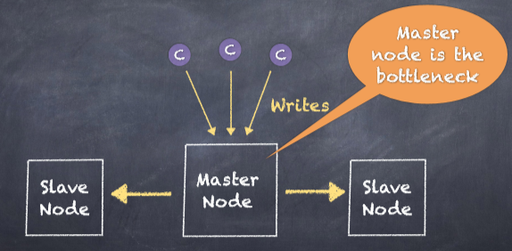
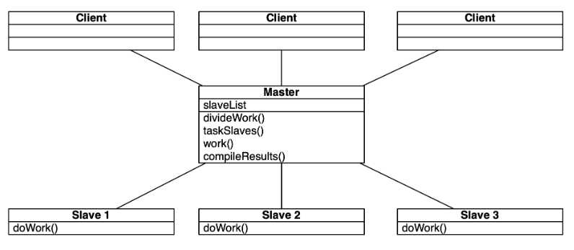
Architecture - Original Strategy
Original Strategy: Master - Slave
Single Master.
Master Propagates any state change to it replicas.
Pros:
Strong Consistency.
Cons:
Severe bottleneck in the system

Slide 8

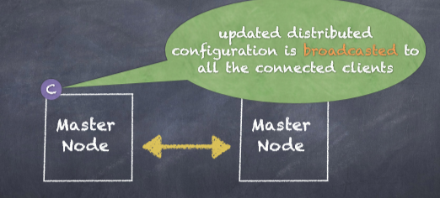
Architecture - Current Strategy
New paradigm
Multi-Master Architecture
Hazelcast Role
Load Balancing Configurations
STICKY
Strong Consistency, High Latency
ROUND_ROBIN_CONNECT
Session Consistency
ROUND_ROBIN_REQUEST
Eventual Consistency, Low Latency

Slide 9
Features
Partition methods
Horizontal Partitioning
Record Level Security
Replication methods
Multi Master Replication
MapReduce
OrientDB SQL
Supports Hadoop or Spark
In-memory capability
Hybrid
Disk-oriented
In memory
SELECT MAX(amount), COUNT(*), SUM(amount) FROM Client

Slide 10
Features
Server operating systems
Any OS that implements the JVM
Concurrency
Multi Version Concurrency Control
Optimistic -Supported
BEGIN - MODIFY - VALIDATE - COMMIT
Pessimistic - Not Supported
Durability
Fail Over
Auto-recovery
Support for SQL
Compression, indexes, query interface, stored procedure views

Slide 11
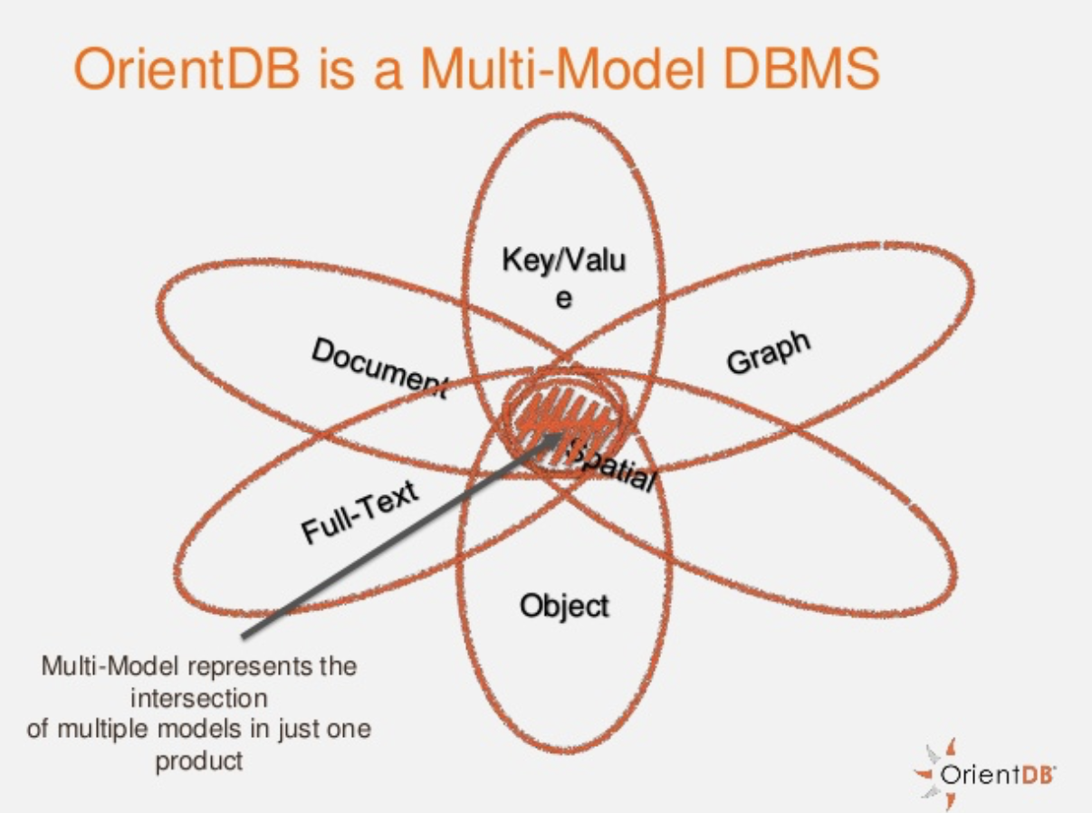
Specific Characteristics
Multiple-Model
A multi-model database is designed to support multi data models against a single, integrated backend. Document, graph, relational, and key-value models are examples of data models that may be supported by a multi-model database.
Notes:
Teleporter for orientDB

Slide 12
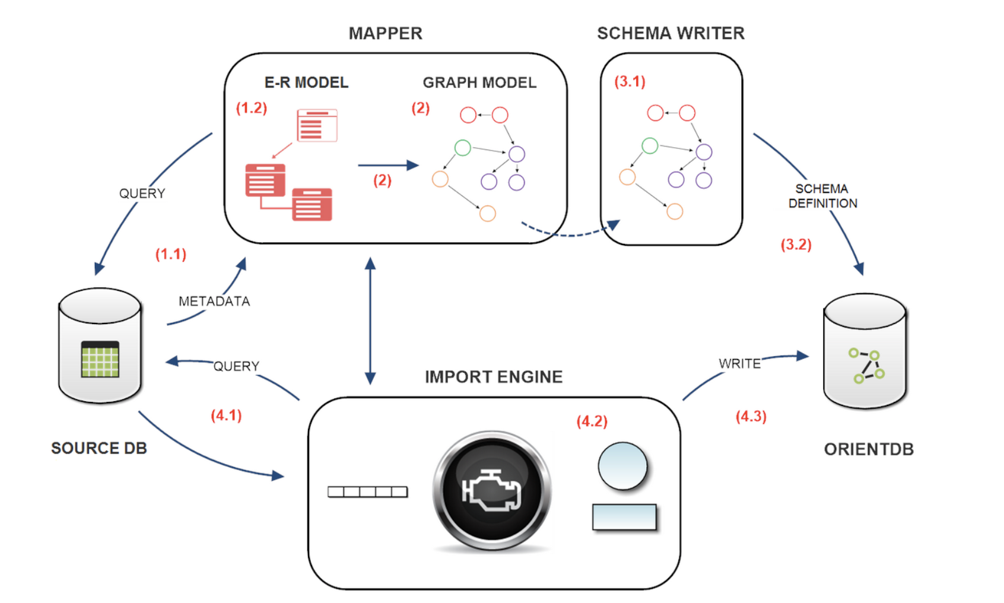
Specific Characteristics
Teleporter:
OrientDB Teleporter is a tool that synchronizes a RDBMS to OrientDB database. It allows relational databases to be quickly imported into OrientDB in a few simple steps.
Notes:
Teleporter for orientDB

Slide 13
OrientDB Compared to Other Databases

Slide 14
OrientDB Capabilities | OrientDB | MongoDB | Neo4J | MYSQL
Operational Database | x | x |  | x
Graph Database | x |  | x
Document Database | x | x
Object-Oriented Concepts | x
Shema-full, schema-less. Schema-mix | x
SQL | x |  |  | x
Linked Documents | x |  | x | x
Custom Data Types | x | x |  | x
Embedded Documents | x | x

Slide 15
OrientDB Features | OrientDB | MongoDB | Neo4J | MYSQL
User and Role & Record Security | x
Record and Level Locking | x |  | x | x
ACID Transaction | x |  | x | x
Multi-Master Zero Configure Replication | x
Sharding | x | x
Server Slide Functions | x | x |  | x
Native HTTP Rest/JSON | x | x
Embedded Without Restrictions | x
User and Role & Record Security | x

Slide 16
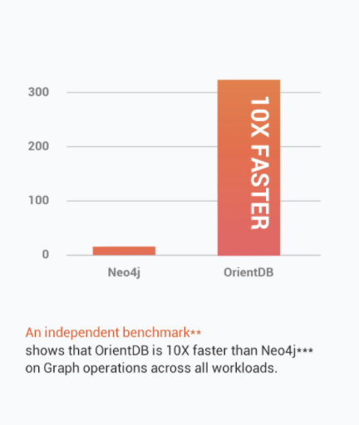
Competitive Advantages
Powerful
Scales linearly
ACID compliant
High Efficiency
Flexible
“The first multi-model open source NoSQL database”
Graphs
Documents, key/value, reactive, object-oriented, and geospatial models

Slide 17
Drawbacks
Bugs
Periods of low stability
Breakdown of accessibility
Dropped Transactions - reports of dropped financial transactions
Security Exploit with null password
Magnifying issues
Preference to new features over fixing bugs
Poor Documentation
Can be difficult for beginners

Slide 18
Use Cases
Specializations:
In-place preparation for varied data models
Multi-model projects
Time series
Chat rooms
Queue systems
Features:
Scales linearly and efficiently
Allows both graphs and documents
Can support ACID
Best Case:
The full nature of the project is unknown, but is likely to involve relational datasets
A variety of features may be needed
ACID compliance may be required

Slide 19
NOT Use Cases
The strengths don’t help when:
The project is limited in scope and has a known size from the start
The project requires only one model of data
The amount of data is relatively small
The weaknesses hurt most when:
The project is mission critical
Your coding time and skills are limited
Example:
Medical Records

Slide 20
Current Users

Slide 21
Key Industries
Entertainment
Technology
Government
Health
Finance

Slide 22


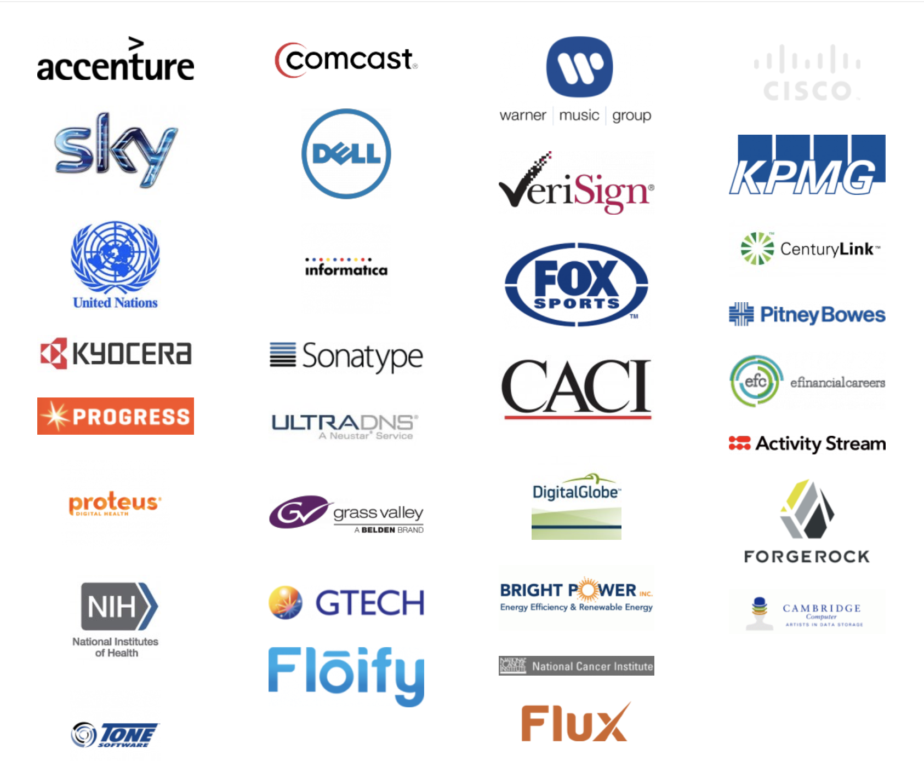
Key Customers

Slide 23
Case Study 1: Wanda Group - 99Bill
Introduction
99Bill Corporation is a leading independent third- party payment service provider in China. It ranked 380th on Fortune Global, offers a comprehensive suite of convenient electronic payment solutions to (more than one million) merchant partners. 99Bill’s services enable electronic payment transactions via kiosks, Internet, mobile phone, and point-of-sale devices across the country. Its services work with three billion domestic and international bank cards, including VISA and MasterCard.

Slide 24
Case Study 1: Wanda Group - 99Bill
Challenges
Fraudulent Transactions are inevitable and cause ongoing challenges
Existing RDBMS was too SLOW and EXPENSIVE to catch fraudulent ecommerce payments transactions as they are occuring, rather than after the fact.

Slide 25
Case Study 1: Wanda Group - 99Bill
Benefits
20% INCREASE in Fraud Detection
“OrientDB can do in milliseconds what our RDBMS could never do. With it, we are much more effective at catching fraudulent activity in real time.” -- Kisho Dai, Team Lead
400% FASTER
Queries are 400% faster than market leading RDBMS
EASY
OrientDB is easy to use and there is no learning cost because developers already know SQL and JDBC

Slide 26
Case Study 2: BiG Consultancy
BiG Consultancy
A London-based consulting company that specializes in helping companies successfully deploy data strategies and technologies. They deal with real-time and high-volume streaming data, leverage the new wave of machine learning technologies or and transform businesses into a data-driven enterprise to solve their problems.

Slide 27
Case Study 2: BiG Consultancy
Challenges
The ability to work with high velocity, schema-free, big data
Collaborative filtering to understand intents of individuals interacting with their business
High scalability

Slide 28
Case Study 2: BiG Consultancy
Benefits
Significant increases in money invested into businesses raising on the Crowdcube crowdfunding platform.
Increased average click through rate on their site by 25%
In one case when comparing the hyper-personalization made possible by OrientDB, BiG saw a 56% increase in click-through-rates, which amounts to £8.26 vs. £0.22 investment made per email recipient

Slide 29
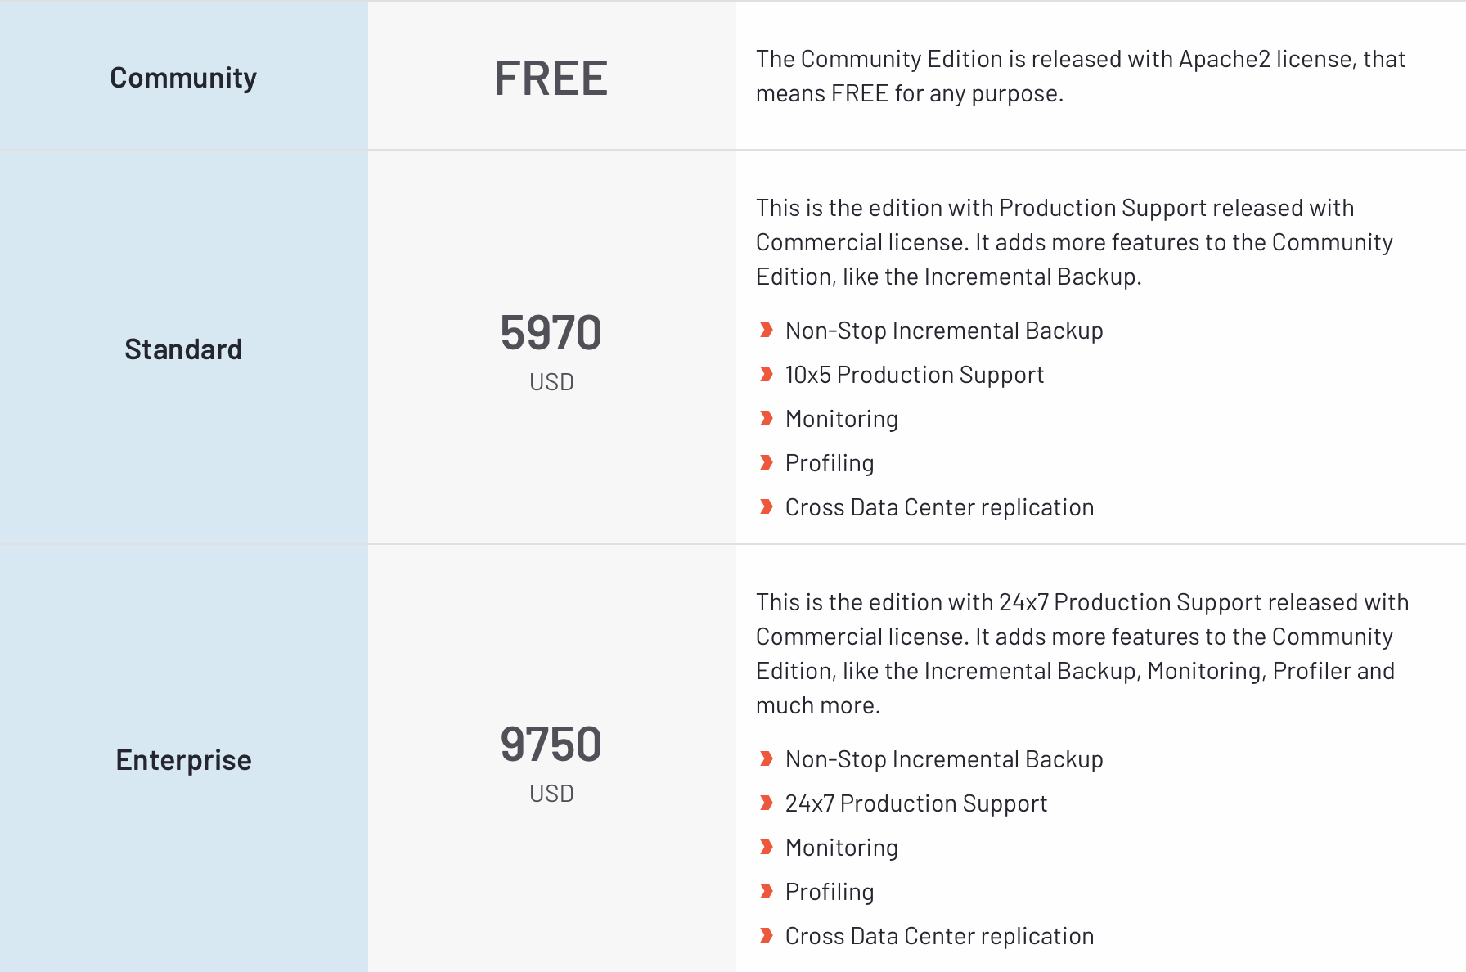
Licensing and Pricing Models
Community edition is FREE for any user, even the Commercial version. No hidden restrictions.
Apache 2 license
Enterprise edition:
Included with any Subscription package( Contact Sales for Pricing). 45 days Trial for Development only.
Commercial license
Notes:
https://www.g2.com/products/orientdb/pricing

Slide 30
Cloud-based OrientDB
OrientDB can be deployed in the cloud
Cloud services provide:
Upward scalability
Seamless configuration
Reliable security

Slide 31
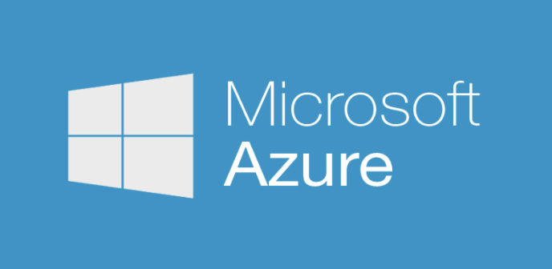




OrientDB Cloud Pricing
OrientDB’s price in the cloud is contingent on the:
Cloud service provider
Instance type
Location
Tier - Community or Enterprise
Notes:
OrientDB deployed in the cloud by trusted cloud providers and does not have it’s own in-house Cloud deployment.
Community vs. Enterprise, as Zoey spoke about before.

Slide 32
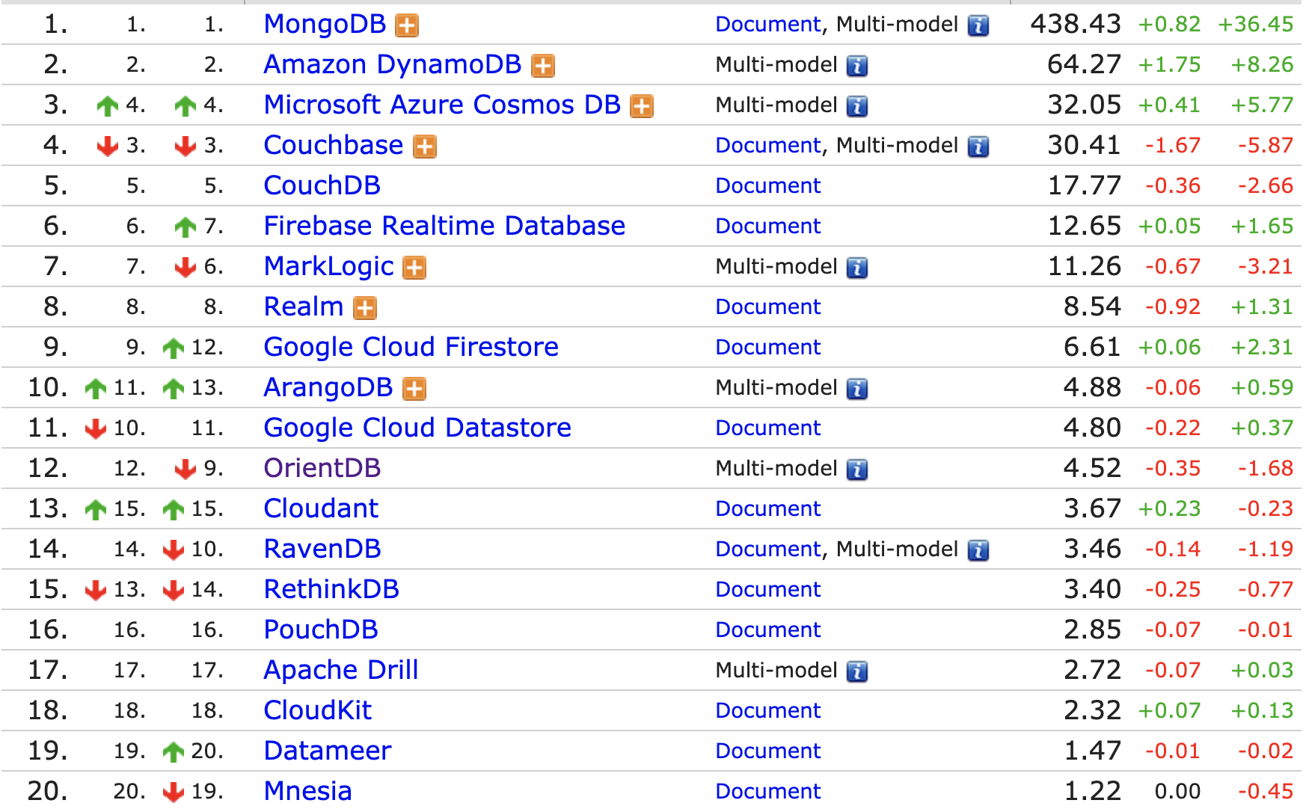
Market metrics
“10X faster than rivals!”
Notes:
Ranked third as of 2017; Ranked 9th in 2019; Ranked 12th in 2020
80K downloads/month

Slide 33
Conclusion
OrientDB is:
A multi-modal database system, with a specialty in graph databases
It’s designed to be Fast, Scalable, and Flexible
It includes a wide variety of features, at the cost of complex and sometimes buggy code

Slide 34
References
Case Studies, White Paper, and Success Stories. (n.d.). Retrieved from https://orientdb.com/case-studies/
Engines Ranking. (n.d.). Retrieved from https://db-engines.com/en/ranking/document store
Graph Database: Multi-Model Database. (n.d.). Retrieved from https://orientdb.com/
In the Cloud: OrientDB Community Edition. (n.d.). Retrieved from https://orientdb.org/cloud
Messina, A. (2018, August 1). Figure 2-OrientDB features (courtesy of Orient Technologies LTD) . Retrieved from http://www.researchgate.net/figure/OrientDB-features-courtesy-of-Orient-Technologies-LTD_fig2_303231614
Retrieved from https://stackoverflow.com/questions/39445325/is-there-any-reason-not-to-use-orientdb
Retrieved from https://www.quora.com/Is-there-any-reason-not-to-use-OrientDB-Is-there-any-reason-to-opt-for-MongoDB-or-Neo4j
Retrieved from https://www.g2.com/products/orientdb/pricing

Slide 35
Demo
Orientdb | Version 3.0.29 | Demo

